Slide 1


Mastering Flutter: From Beginner to Pro.
joeshwoa.george@gmail.com
Session 10: Pubspec and Permissions

Slide 2
Do not skip any information without understanding it.
joeshwoa.george@gmail.com
― Joeshwoa George

Slide 3
Any questions?
joeshwoa.george@gmail.com
Don;t forget study this section well and write your questions in note and i will answer it in live session.

Slide 4
Table of Contents.
Overview of pubspec.yaml
Assets, Fonts and Icons Integration
Configuring AndroidManifest.xml
Q&A and Wrap-Up
01
02
What is pubspec.yaml?, Structure of pubspec.yaml, Add Packages.
Assets, Fonts and Custom Icons.
03
04
What is AndroidManifest.xml? and Permissions.
Let's ask
joeshwoa.george@gmail.com

Slide 5
Overview of pubspec.yaml.
01
Let’s Start with
What is pubspec.yaml?
joeshwoa.george@gmail.com

Slide 6
What is pubspec.yaml?
A configuration file for Flutter projects.
Defines project metadata, dependencies, assets, fonts, and more.
joeshwoa.george@gmail.com

Slide 7
Structure of pubspec.yaml
Name, Description, Version: Project metadata.
Dependencies: External libraries/packages.
Dev Dependencies: Tools for development (e.g., testing frameworks).
Assets: Images, audio, and other resources used in the app.
Fonts: Custom fonts.
joeshwoa.george@gmail.com

Slide 8
Example Structure
name: my_flutter_app
description: A new Flutter project.
version: 1.0.0+1
dependencies:
flutter:
sdk: flutter
http: ^0.15.0
flutter:
assets:
- assets/images/
fonts:
- family: Roboto
fonts:
- asset: fonts/Roboto-Regular.ttf
joeshwoa.george@gmail.com

Slide 9
How to Add Packages
Visit pub.dev to search for packages.
Add the package under the dependencies section in pubspec.yaml.
Run flutter pub get to install the package.
Example: Adding the http package:
dependencies:
http: ^0.15.0
joeshwoa.george@gmail.com

Slide 10
Assets, Fonts and Icons Integration.
02
Let’s Start with
Assets Integration
joeshwoa.george@gmail.com

Slide 11
Assets Integration
Adding Assets
Create an assets folder in the root directory.
Add subfolders like images, audio, etc.
Update pubspec.yaml to include the asset paths.
Example:
joeshwoa.george@gmail.com
flutter:
assets:
- assets/images/logo.png
- assets/audio/theme_song.mp3

Slide 12
Using Assets in Code
For images:
For audio files: Use relevant packages like audioplayers to play audio.
Image.asset('assets/images/logo.png');
joeshwoa.george@gmail.com

Slide 13
Fonts Integration
Adding Custom Fonts
Download font files (e.g., from Google Fonts).
Place them in a fonts folder.
Update pubspec.yaml to configure the font.
joeshwoa.george@gmail.com

Slide 14
Fonts Integration
Example:
flutter:
fonts:
- family: OpenSans
fonts:
- asset: fonts/OpenSans-Regular.ttf
- asset: fonts/OpenSans-Bold.ttf
weight: 700
joeshwoa.george@gmail.com

Slide 15
Using Fonts in Code
Example:
Text(
'Hello, Flutter!',
style: TextStyle(fontFamily: 'OpenSans', fontSize: 18),
);
joeshwoa.george@gmail.com

Slide 16
Custom Icons Integration
Using Flutter's flutter_launcher_icons Package
Add the package to dev_dependencies.
Add icon configuration in pubspec.yaml.
dev_dependencies:
flutter_launcher_icons: ^0.9.2
joeshwoa.george@gmail.com
flutter_icons:
android: true
ios: true
image_path: "assets/icons/app_icon.png"

Slide 17
Custom Icons Integration
Run the command:
flutter pub run flutter_launcher_icons:main
joeshwoa.george@gmail.com

Slide 18
Configuring AndroidManifest.xml.
03
Let’s Start with
What is AndroidManifest.xml?
joeshwoa.george@gmail.com

Slide 19
What is AndroidManifest.xml?
A configuration file for Android apps.
Defines permissions, application name, and settings.
Adding Permissions For Android
Navigate to android/app/src/main/AndroidManifest.xml.
Add required permissions.
joeshwoa.george@gmail.com
<uses-permission android:name="android.permission.INTERNET" />
<uses-permission android:name="android.permission.CAMERA" />

Slide 20
Setting Application Name For Android
Modify label in the <application> tag:
<application
android:label="My Flutter App"
android:icon="@mipmap/ic_launcher">
</application>
joeshwoa.george@gmail.com

Slide 21
Q&A and Wrap-Up.
04
Let’s Start with
Any questions in this session?
joeshwoa.george@gmail.com

Slide 22
Homework
Create a new Flutter project that uses:
A custom font for all text.
A custom app icon.
Add Images.
Add permissions for accessing the internet and camera.
Change the app name to arabic name.
Submit your project with a screenshot of the running app.
joeshwoa.george@gmail.com

Slide 23
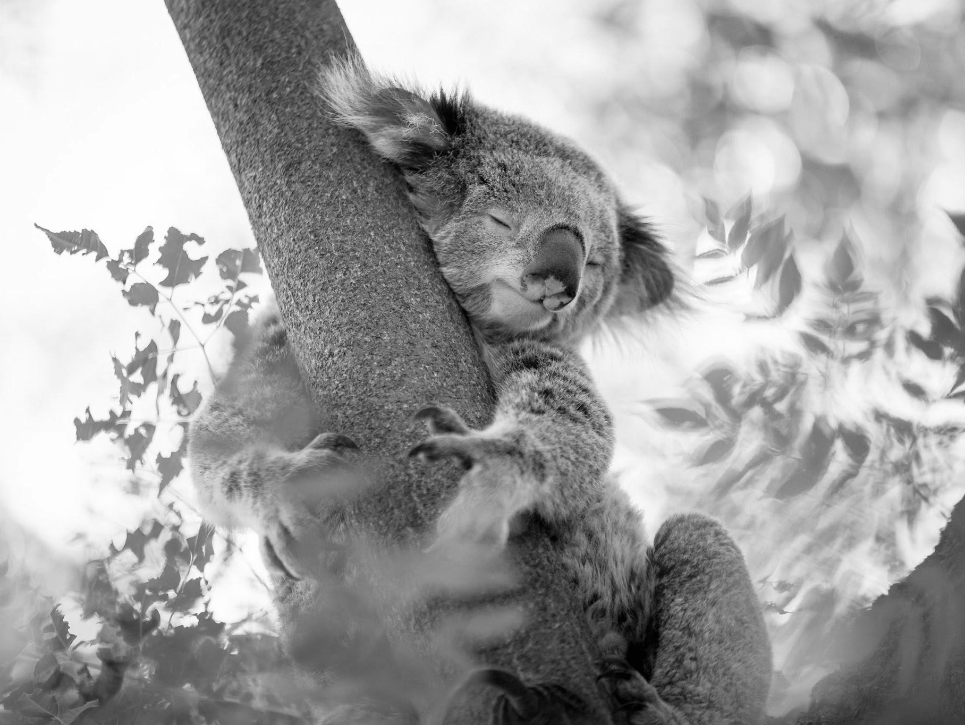
OFFFFF Take a brack.
joeshwoa.george@gmail.com
Only Koalas don’t have much energy and, Koala can sleep for up to 18 hours a day but you only need 6-8 hours to have all energy needed energy for one day.

Slide 24
So, Don’t Wast Your Time in Sleep.
joeshwoa.george@gmail.com
― Joeshwoa George

Slide 25
See you next session!
joeshwoa.george@gmail.com
Don;t forget study this section well and write your questions in note and i will answer it in live session.

Slide 26

Thank you!
Do you have any questions?
joeshwoa.george@gmail.com
+20 120 294 6596
joeshwoa.george@gmail.com

